Slide 1
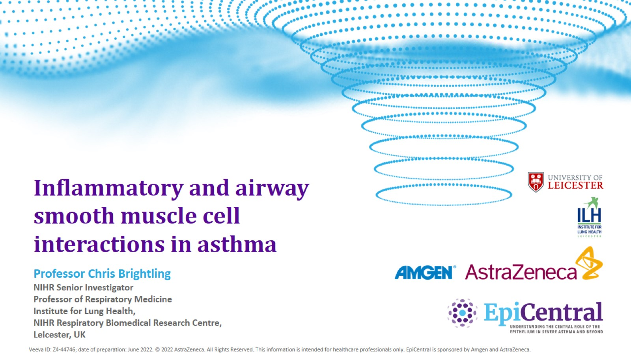
Inflammatory and airway smooth muscle cell interactions in asthma
CN-142720; date of preparation: Dec 2024. © 2025 AstraZeneca. All Rights Reserved. This information is intended for healthcare professionals only. EpiCentral is sponsored and developed by Amgen and AstraZeneca.

Slide 2
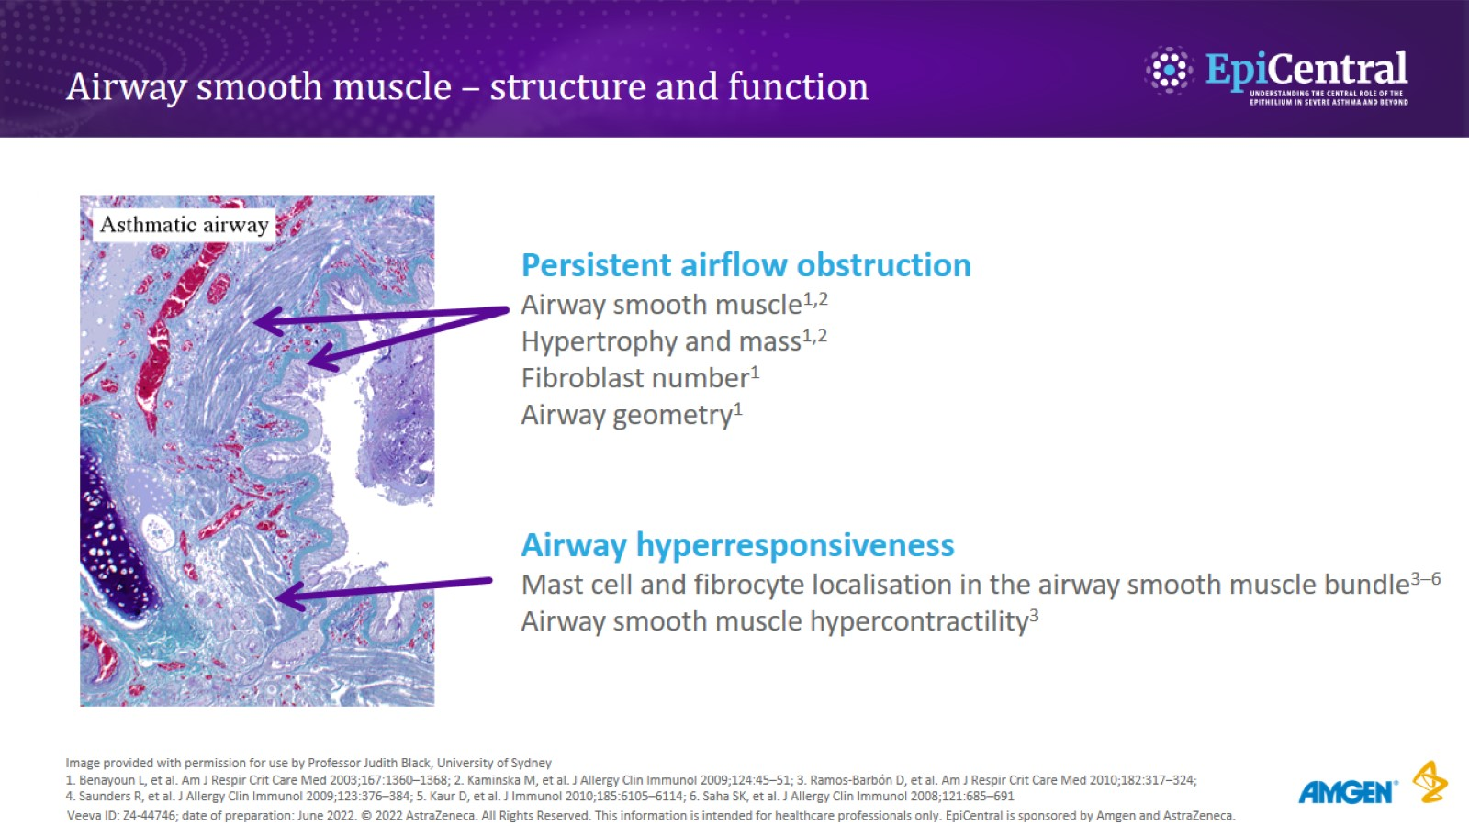
Airway smooth muscle – structure and function
CN-142720; date of preparation: Dec 2024. © 2025 AstraZeneca. All Rights Reserved. This information is intended for healthcare professionals only. EpiCentral is sponsored and developed by Amgen and AstraZeneca.

Slide 3
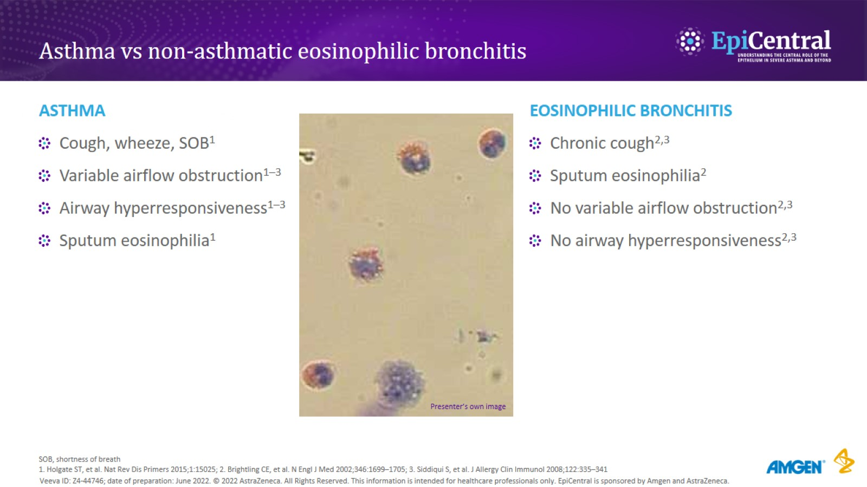
Asthma vs non-asthmatic eosinophilic bronchitis
CN-142720; date of preparation: Dec 2024. © 2025 AstraZeneca. All Rights Reserved. This information is intended for healthcare professionals only. EpiCentral is sponsored and developed by Amgen and AstraZeneca.

Slide 4
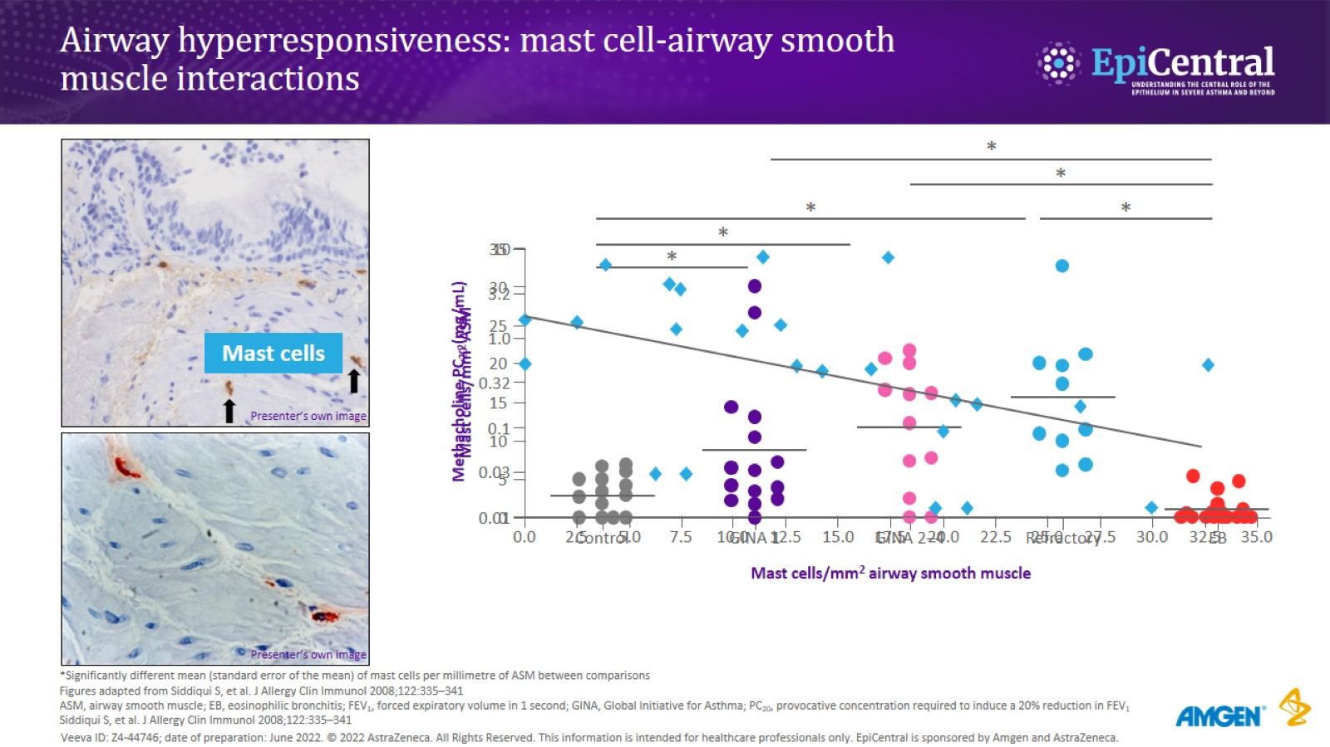
Airway hyperresponsiveness: mast cell-airway smooth muscle interactions
CN-142720; date of preparation: Dec 2024. © 2025 AstraZeneca. All Rights Reserved. This information is intended for healthcare professionals only. EpiCentral is sponsored and developed by Amgen and AstraZeneca.

Slide 5
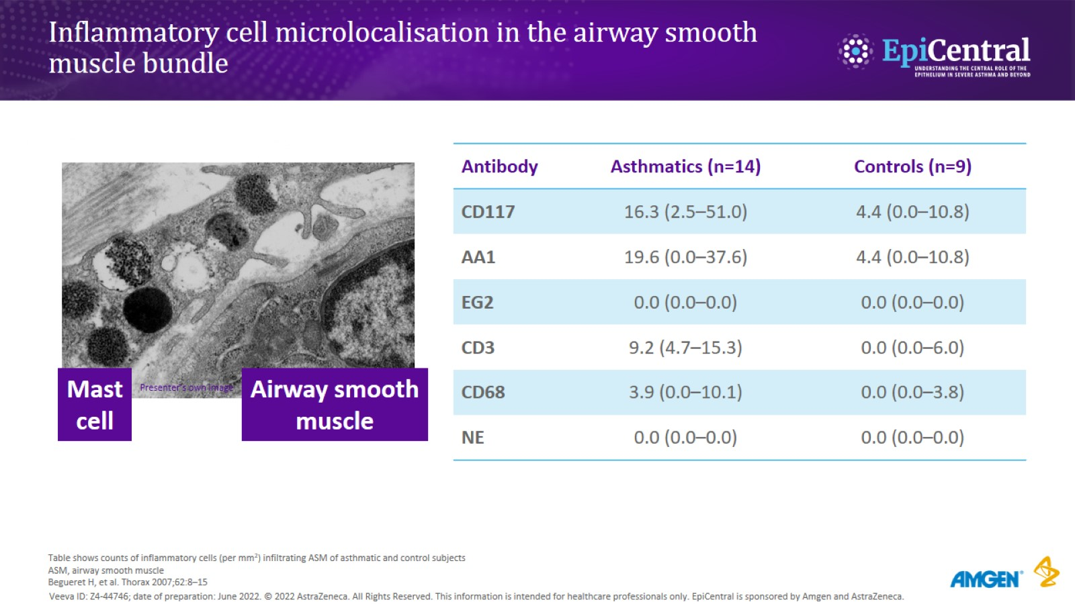
Inflammatory cell microlocalisation in the airway smooth muscle bundle
CN-142720; date of preparation: Dec 2024. © 2025 AstraZeneca. All Rights Reserved. This information is intended for healthcare professionals only. EpiCentral is sponsored and developed by Amgen and AstraZeneca.

Slide 6
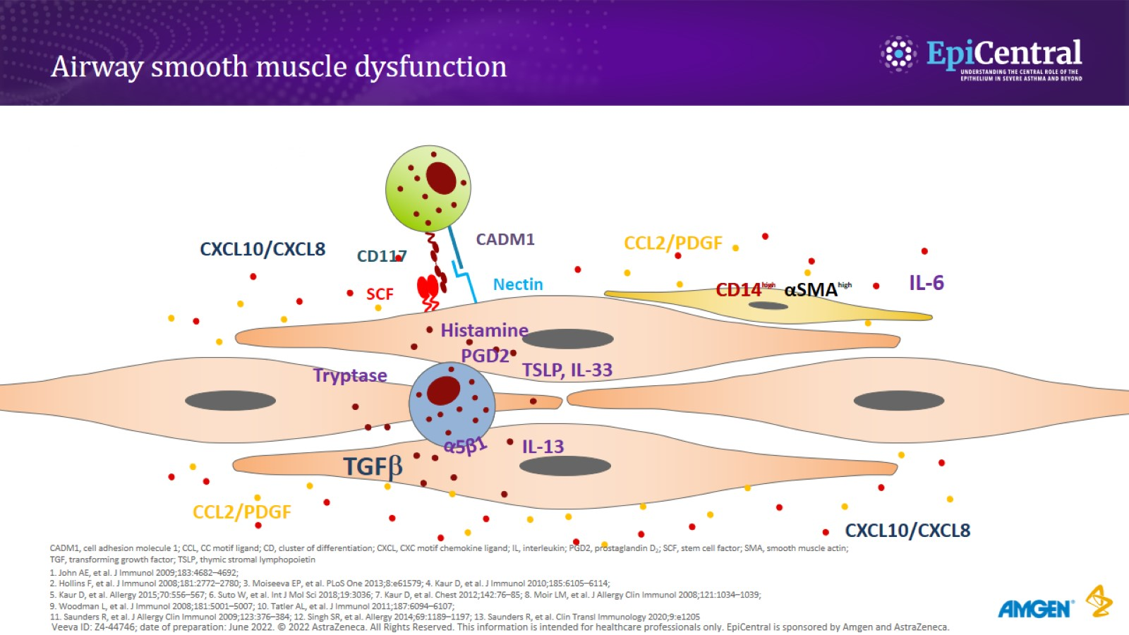
Airway smooth muscle dysfunction
CN-142720; date of preparation: Dec 2024. © 2025 AstraZeneca. All Rights Reserved. This information is intended for healthcare professionals only. EpiCentral is sponsored and developed by Amgen and AstraZeneca.

Slide 7
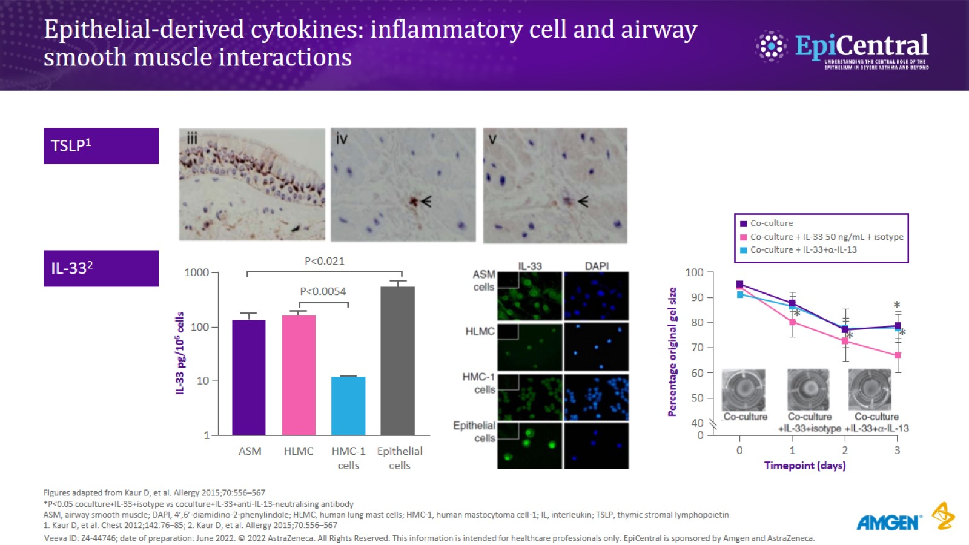
Epithelial-derived cytokines: inflammatory cell and airway smooth muscle interactions
CN-142720; date of preparation: Dec 2024. © 2025 AstraZeneca. All Rights Reserved. This information is intended for healthcare professionals only. EpiCentral is sponsored and developed by Amgen and AstraZeneca.

Slide 8
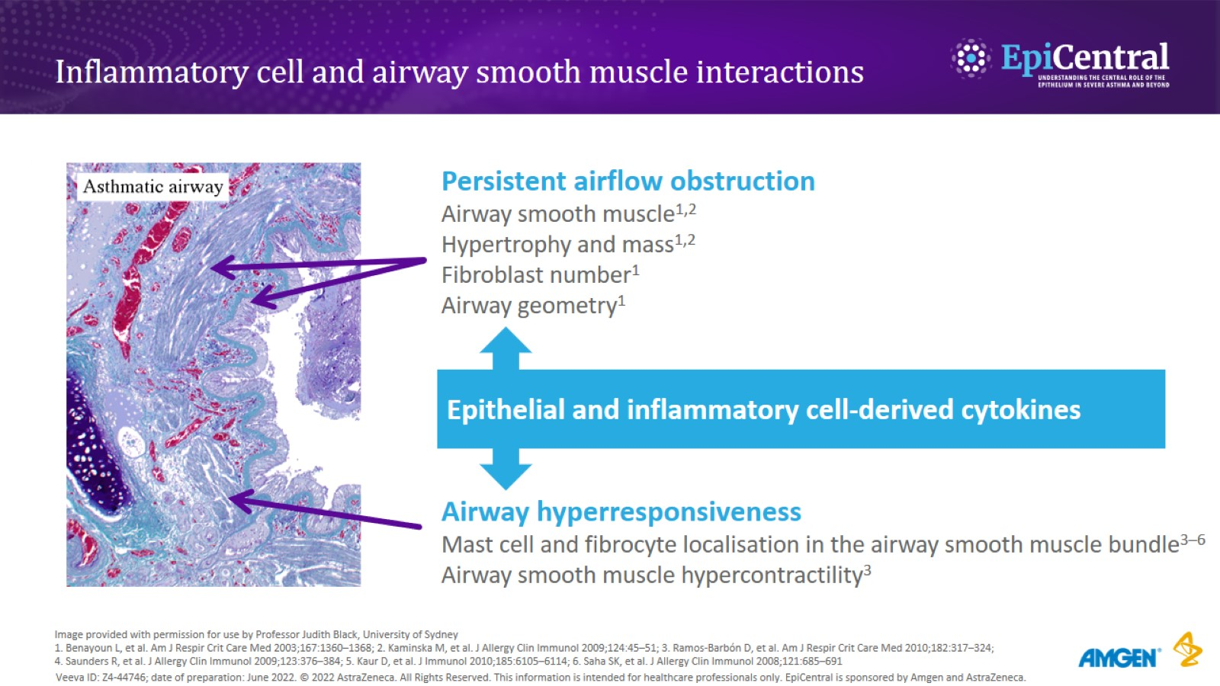
Inflammatory cell and airway smooth muscle interactions
CN-142720; date of preparation: Dec 2024. © 2025 AstraZeneca. All Rights Reserved. This information is intended for healthcare professionals only. EpiCentral is sponsored and developed by Amgen and AstraZeneca.

Slide 9
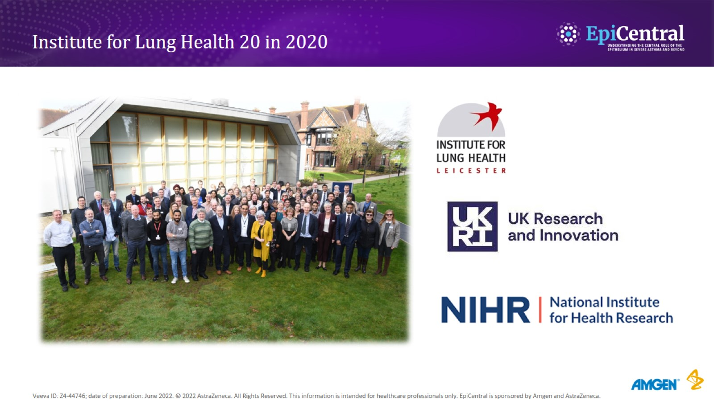
Institute for Lung Health 20 in 2020
CN-142720; date of preparation: Dec 2024. © 2025 AstraZeneca. All Rights Reserved. This information is intended for healthcare professionals only. EpiCentral is sponsored and developed by Amgen and AstraZeneca.

